Slide 1


Stock Performance Review (2017)
Stephen Ellingson

Slide 2

OVERVIEW
Distribution of Stock Prices Per Quarter (violin plot)
Estimated and Actual Earnings Per Share (scatter plot)
Earnings and Revenue Per Quarter (bar graph)
Stock Price Comparison – Netflix vs. DJI Average (line graph subplots)

Slide 3
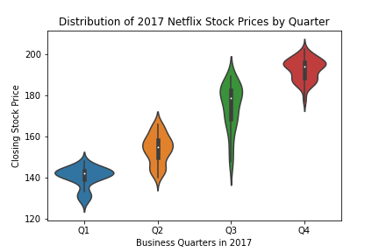
Distribution of Stock Prices Per Quarter
Average closing stock price increased each quarter by around the same amount.
Q1 and Q4 saw clustered prices, while Q2 and Q3 were spread over a comparatively larger range.
Prices in 2017 fell within the $140-$200 range.
Highest price was in Q4 at approx. $210, while Q1 saw the lowest price at about $122.

Slide 4
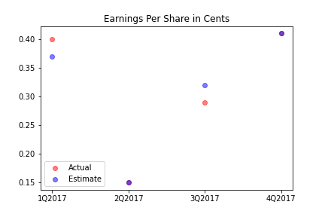
Estimated and Actual Earnings Per Share
Q2 and Q4 estimates were spot on with actual earnings, with $0.15 and $0.41, respectively.
Estimates for Q1 were low, while Q3 estimates exceeded actual earnings per share.
Differences in estimations to actual earnings for both Q1 and Q3 are approx. $0.05.

Slide 5
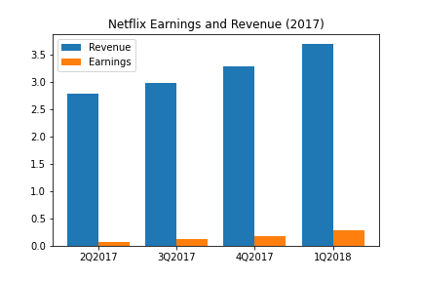
Earnings and Revenue Per Quarter
Revenue follows an exponential growth from Q1 2017 to Q1 2018
Earnings have a slightly more linear growth during that same time frame.
Earnings for each quarter make up about 5% of that quarter’s total revenue.

Slide 6
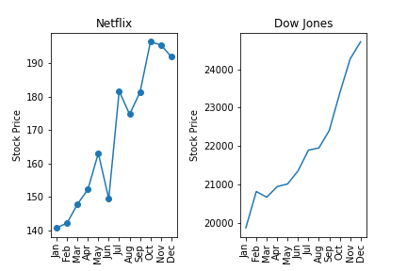
Stock Price Comparison – Netflix vs. DJI Average
Netflix performed relatively the same as the DJI Average in 2017.
Netflix was also more volatile from several time frames (June to July being a good example).
Netflix's stock price is significantly less than that of the Dow Jones.

